Slide 1
2024 LOI Applicant Webinar
Ability Central Philanthropy
Notes:
Welcome to Ability Central Philanthropy's 2024 LOI Applicant Webinar.
Intro Jessie
My name is Jessie Galloway, pronouns are she/her. I am a white woman with short red curly hair wearing a blue, green, and magenta plaid shirt. I am wearing round tortoiseshell glasses. I want to acknowledge the land of the Hopewell peoples that I am currently located on, and the Ability Central office which is located on unceded Ohlone land.

Slide 2
Housekeeping
Please use the Q&A function to ask your questions throughout the presentation
There will be a Q&A portion at the end of the presentation
If your question is not answered, or you have a more in-depth question, you can follow up via email with Jessie Galloway at jgalloway@abilitycentral.org
Notes:
Before we get started, I wanted to go over a few housekeeping rules first. Please use the Q&A function to ask questions throughout. We will stop after each section to answer questions and there will be a Q&A at the end.
Jessie

Slide 3
Agenda
Ability Central Mission and Process Overview
2024 Funding Priorities
How to log in to the portal and apply
Application Questions and Example Answers
Budget Questions and Budget Template
Scoring Criteria
Questions
Notes:
Alyah

Slide 4
Our Mission
Ability Central is committed to improving communication and information access for people who are Deaf, disabled, and neurodivergent experiencing access and functional needs.*
We serve as a funder, educator, and convener working collaboratively with our grantee partners, other funders, and the disability community to integrate effective communication solutions.
*Examples include blindness, low-vision, people who are Deaf, hard of hearing, Deafblindness, speech disabilities, intellectual and developmental disabilities, ADHD, dyscalculia, and dyslexia, and more.
Notes:
Alyah

Slide 5
LOI Process Overview
±$1 million granted annually (averages to about 15 grant awards per cycle).
Grants range from $10,000 – $100,000.
California-only funding.
General operating support up to 25% of request.
Annual grant cycle is a two-stage application process, beginning with Letter of Intent (LOI) through an online grants management system. Due July 12 at 5pm Pacific.
LOI review process takes approximately five weeks.
All LOIs are reviewed and scored by two staff, advisory group members, and decided upon by our Grants Team which includes executive staff and board members.
Notification of invitation to submit a full proposal will be sent on August 25, 2023.
Notes:
Alyah

Slide 6
Full Application Process Overview
If invited to submit a full application, it will be due on October 4, 2023 at 5pm Pacific.
Applications are reviewed and scored by two staff, advisory group members, and decided upon by the board (process is approximately seven weeks).
Notification of Award will be in mid- to late-November 2023.
Once approved, and grant agreements are finalized, funds are disbursed in semi-annual installments of 50% of award amount in December and August.
Notes:
Alyah

Slide 7
Funding Priorities
Our 2024 funding cycle for Communication Access projects encourages:
Leadership Development
Healthcare Training
Innovation and Digital Accessibility Improvement
All projects should be working toward improved access for people with communication disabilities.
Notes:
Alyah:
Career and leadership development projects for people with communication disabilities.
We are seeking strong, scalable, and replicable projects that provide supportive and fairly-compensated career training opportunities for people with communication disabilities.
We seek projects that:
Demonstrate understanding of the unique challenges faced by people with communication disabilities in accessing career development opportunities.
Utilize innovative and effective strategies for providing support to participants with communication disabilities throughout the career training process.
Have or will establish partnerships with relevant stakeholders, including self-advocates, disability organizations, employers, colleges, and/or training institutes.
Include accommodations (interpreters, screen reader-friendly documents, AAC, etc.) and project staff/mentors that are familiar with them to enhance accessibility and participation.
Incorporate a person-centered approach, considering the individual strengths, preferences, and goals of participants with communication disabilities.
Measure outcomes and evaluation methods to assess the effectiveness of the career training program and its impact on participants’ employment outcomes.
Plan for sustainability beyond the grant period, including strategies for long-term funding, partnerships, and ongoing support for participants.
Describe the project’s scalability, indicating the potential for expansion and replication in other settings or regions.
Commit to a disability inclusion framework within their organization.
Developing and training healthcare professionals in strategies and tools that improve access to care for people with communication disabilities.
We are looking for projects to develop, train, and implement resources and programmatic models for people with disabilities who communicate and access information via methods such as braille, screen readers, American Sign Language (ASL), tactile interpreters, co-navigators, and/or Augmentative and Alternative Communication (AAC).
This project is intended to train and equip healthcare professionals and healthcare systems with the knowledge, accessible resources, and multi-modal communication partner strategies to improve culturally responsive care for patients with communication disabilities and their care teams. These projects should be replicable and include people with disabilities in the planning, training, and implementation.
We encourage projects that incorporate these elements:
Person-Centered Approach: Successful culturally responsive healthcare training projects for people with communication disabilities should prioritize a person-centered approach. This means that the training should focus on the individual needs and preferences of the person, and the training should empower the person to be an active participant in their healthcare decisions.
Communication Access: Successful projects should prioritize and understand access needs. This includes accommodations such as sign language interpreters, captioning, assistive technology, etc., that allow individuals to communicate effectively with healthcare providers.
Collaboration: Healthcare training projects should involve multidisciplinary collaboration to ensure that all aspects of a person’s health needs are addressed. This could include collaborating with healthcare administration, front line staff such as doctors, nurses, medical assistants, behavioral health therapists, social workers, occupational therapists, appointment schedulers, and/or other professionals whose interactions impact the medical care of individuals with communication disabilities.
Ongoing Evaluation: Successful projects should include ongoing evaluation to ensure that the training is effective and meets the needs of individuals with communication disabilities. This includes collecting feedback from both healthcare providers and individuals with communication disabilities to identify areas for improvement and make necessary adjustments to the training.
Innovation and digital accessibility projects.
Our major funding encourages the implementation of innovative technologies, services, and solutions benefiting people with disabilities. Grant awards range between $10,000 and $100,000.
Ability Central defines innovation as the development of a new concept into a valuable solution that expands access for people with disabilities when applied and scaled. We encourage innovation with the potential to impact people far beyond the initial study or pilot participants.
We are not currently funding research projects or studies that are not yet ready to be implemented.
Digital accessibility makes it easier for people with communication disabilities to access information, communicate effectively, engage in app-based programs, and participate fully in the digital world.
Projects eligible for funding can include:
Designing interfaces and applications that can be navigated and operated with assistive technologies such as screen readers, screen magnifiers, alternative input devices, or switch control systems, allowing individuals with disabilities to access and interact with digital content effectively.
Providing a clear and consistent structure, well-organized content, and intuitive navigation features on a digital platform, enabling individuals with cognitive or learning disabilities to locate and access information efficiently.
Offering options for users to personalize a digital interface, adjust font sizes, colors, contrast, or other visual settings, and control the pace of content delivery, accommodating individual preferences and needs.
Testing and Validation: Conducting regular accessibility assessments and user testing involving individuals with communication disabilities to identify and address barriers, ensuring that digital content and platforms meet recognized accessibility standards and guidelines.
If you are proposing website or app accessibility, the content must have a distinct purpose that serves people with disabilities.
We prioritize projects that employ human-centered, universal design by involving the perspectives of people with disabilities in all steps of the process. We seek cutting-edge technology that will benefit everyone by including people with disabilities from the start. Planning and testing must include people with disabilities, and people with disabilities must be compensated.
As part of the grant requirements, grantees need to publicly share the results of their project to benefit the greater community by producing at least one of these:
Article/paper
Website
App
Presentation
Open-sourcing (making specifications of a device, app, or program available for public use or modification)

Slide 8
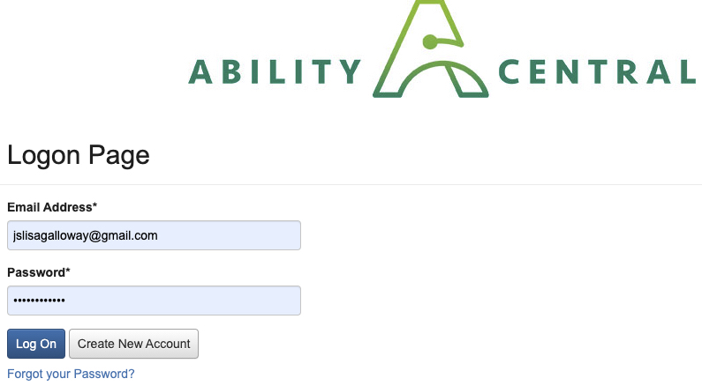
Login
https://www.grantinterface.com/Home/Logon?urlkey=ccaf
Notes:
Jessie
This is a screenshot of our login page to our online system.
It's a good idea to bookmark the site.

Slide 9
Applicant Dashboard
Notes:
Jessie

Slide 10
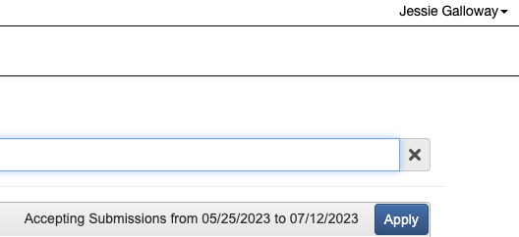
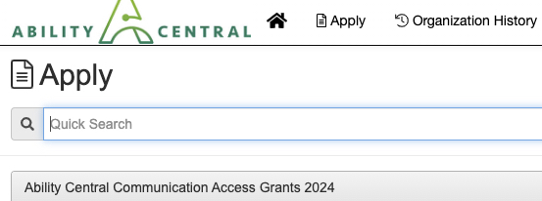
Apply
Notes:
Jessie

Slide 11
Application Questions (1/8)
Project Purpose: What will the funds be used for?
Example answer:
Ability Central funds will support the AAC Institute of Oakland to pilot a three-part video training series led by three paid self-advocate trainers that use AAC in two clinical settings to improve healthcare communication access.
Notes:
Jessie

Slide 12
Application Questions (2/8)
Mission, History, Core Programs
Please tell us more about your organization's mission, its history, core programs, and any significant accomplishments you'd like to share. Bullet points are encouraged.
Example answer:
Our mission is to serve people with disabilities that benefit from AAC to communicate.
History: We were founded in 2013 by…out of the need for…and we have continued to grow, successfully and consistently offering three core programs:
1.
2.
3.
We have received service awards for the last three consecutive years, trained over 3,000 professionals, and served over 10K people with disabilities in our 10-year history.
Notes:
Jessie

Slide 13
Application Questions (3/8)
Project Description
Please tell us about your project, what it proposes to accomplish, and why your organization is the one to do the work. Bullet points encouraged.
Example answer:
Our project will improve communication between front-line clinical staff and patients that use AAC. We will pilot a three-part video training series. It will include:
1. Self-advocate patient experience impact stories
2. Strategies and Tools to have on hand to listen and convey information directly to the patients with disabilities
3…….
We have ongoing partnerships with two clinics in Alameda County and we’ve…in the past. We have SME in curriculum development for people with disabilities, and we always include people with disabilities in our planning and implementation, because the leadership of those most impacted is crucial to the success of any project’s dissemination.
Notes:
Jessie

Slide 14
Application Questions (4/8)
People with Disabilities in Leadership Does your organization have people with disabilities in paid leadership positions? This can include self-advocate advisory group members, staff, and/or Board? Please elaborate.
Example Answer:
We have a majority of people with disabilities on our Board (60%) including our Board president. We maintain a small staff of five, two of our full-time staff identify as people with disabilities including our Project Director and Coordinator, and we have a self-advocate advisory group that includes six people with various communication disabilities that guide our decision making. All Advisory Group members are paid a stipend of $50/hr for each meeting they attend and $25 for any community surveys we ask them to complete throughout the year.
Notes:
Jessie

Slide 15
Application Questions (5/8)
Engagement & Knowledge Sharing Please tell me how you plan to reach your target audiences, the beneficiaries, and how you plan to share the results. Note, at least one representative from your project will be required to attend a Grantee Gathering in March of 2024 and March 2025 to present and share highlights and lessons learned on your project with peers and other grantees.
Example answer:
We plan to utilize our project coordinator’s expertise in outreach via direct email requests, our website, social media (Twitter 12,000 followers; Facebook 11,000 followers; Instagram 10,000 followers), and newsletter (8,000 subscribers) to reach our target audiences which are caregivers, healthcare professionals, and family members. Indirectly, we will be serving people with disabilities as the recipients of the improved care. We will share the results on all previously mentioned mediums as well as at the Ability Central Grantee Gatherings and in our annual impact report.
Notes:
Jessie

Slide 16
Application Questions (6/8)
Beneficiaries Who are the beneficiaries of the project? Both direct and indirect? (People with disabilities, family members, care teams, etc.)
Example answer:
Indirect: People with disabilities.
Direct: Family members, care teams, and healthcare professionals.
Notes:
Jessie

Slide 17
Application Questions (7/8)
Partners and Collaborators Please name your organizational partners and potential collaborators for this project. Please indicate if you've worked together previously and if they are pending or confirmed.
Example answer:
Confirmed: Kaiser Clinic #1, Kaiser Clinic #2
We have worked with Kaiser in the past (2018-19), having successfully advocated for and guided the implementation of accessible announcements for all patients in the waiting rooms. We utilized self-advocate impact stories to bring awareness to how the current system was not serving folks with communication disabilities well.
Notes:
Jessie

Slide 18
Application Questions: Budget (8/8)
Profit & Loss Statement Please upload your most recent Profit & Loss Statement & Include any budget notes in the text box.
We are looking for your 2022 YTD statement that includes your total income, total expenses, and the total profit or loss at the end of the year.
This should just be a page or a few pages, but not your entire audited financial statement.
Notes:
Jessie

Slide 19
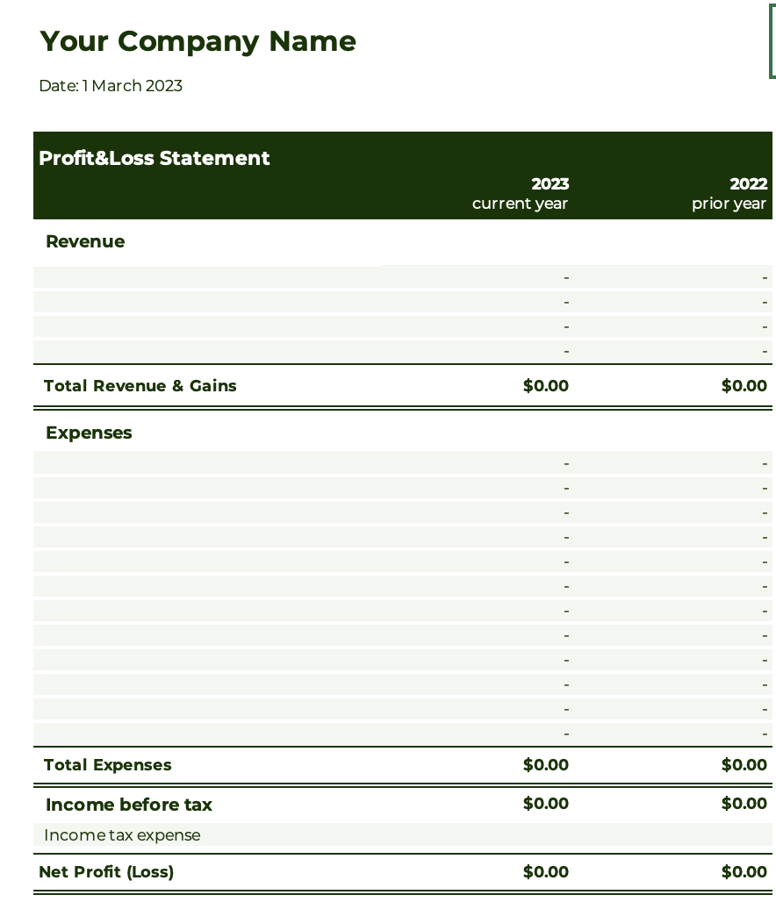
Example Profit & Loss

Slide 20
Application Questions: Budget (con’t.)
Project Budget (use template provided) Please upload a project budget using this TEMPLATE
Download the Drive Document as an excel sheet and complete. Then upload the excel sheet as an attachment. Note, at least one representative from your project will be required to attend a Grantee Gathering in March of 2024 and March 2025 to present and share highlights and lessons learned on your project with peers and other grantees. Please include the cost of travel to and from Oakland, CA for both events in your project budget. This is based on average price of flight, hotel, train, parking, uber, etc.
Notes:
Jessie

Slide 21
Project Budget Template
Notes:
Are there questions on the narrative or budget sections of the application?
Jessie – handoff Scoring Criteria to Alyah

Slide 22
Scoring Criteria (1/8)
Mission (6 points)
Clearly stated organization mission.
Alignment of the project with the organization’s mission.
Demonstrates commitment to the mission and inclusion of people with disabilities in core programs.
History (8 points)
Strong organizational history
Previous successful Grantee partner
Relevance of past activities to the current project (serving people with disabilities).
Significant accomplishments and milestones.
Core Programs (9 points):
Description of the organization’s core programs.
Connection between core programs and the proposed project.
Demonstrated expertise and experience in the relevant field.
Notes:
Alyah

Slide 23
Scoring Criteria (2/8)
Project Description (15 points):
Clear and concise explanation of the project goals and objectives.
Includes activities and strategies to achieve the desired outcomes.
Explanation of why the organization is well-suited to implement the project.
Notes:
Alyah

Slide 24
Scoring Criteria (3/8)
People with Disabilities in Leadership (15 points):
Demonstrates the organization’s inclusion of people with disabilities in paid leadership positions.
Includes examples of individuals in paid leadership roles or advisory positions.
Emphasis on the organization’s commitment to promoting disability leadership.
Notes:
Alyah

Slide 25
Scoring Criteria (4/8)
Engagement & Knowledge Sharing (15 points):
Strategy for reaching target audiences and beneficiaries.
Plan for sharing project results publicly with peers and relevant stakeholders.
Willingness to participate in Grantee Gatherings to present highlights and lessons learned.
Notes:
Alyah

Slide 26
Scoring Criteria (5/8)
Beneficiaries (6 points):
Identification of direct and indirect beneficiaries of the project.
Inclusion of people with disabilities, family members, care teams, etc.
Consideration of the project’s impact on the identified beneficiaries.
Number of People with Disabilities Served (6 points):
Reasonable estimate of the total number of people with disabilities that will be served through the project.
Consideration of the reach, scale, and overall potential impact.
Notes:
Alyah

Slide 27
Scoring Criteria (6/8)
Partners and Collaborators (9 points):
Identification of organizational partners and potential collaborators.
Indication of previous collaborations and successful outcomes.
Confirmation status of partnerships (pending or confirmed).
Notes:
Alyah

Slide 28
Scoring Criteria (7/8)
Profit & Loss Statement and Project Budget (9 points):
Submission of the most recent Profit & Loss Statement.
Demonstration of a balanced financial statement.
Evaluation of the project budget for reasonability and alignment with the proposed activities.
Notes:
Alyah

Slide 29
Scoring Criteria (8/8)
Alignment with Ability Central Priorities (10 points):
Does this project exemplify in design and potential execution of one of the three funding priorities (Leadership Development, Training Healthcare Professionals, and/or Innovation and Digital Accessibility) for people with communication disabilities.
Is this something Ability Central sees as scalable, is interested in seeing come to fruition, and would want to disseminate or share widely.
Notes:
Alyah

Slide 30
Questions?
Email: Jessie Galloway, Program Officer
jgalloway@abilitycentral.org

